Slide 1
Twitch Switch Programmer Diagram

Slide 2
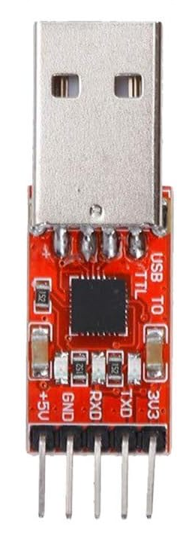
Solderless Breadboard
 | a | b | c | d | e
2 |  | TXD
3
4 |  | RXD |  |  | Mid
5 |  | GND |  |  | GND
CP2102 Programmer
Twitch Switch Sensor PCB
-
3V3
. Diode
VCC
TXD
RXD
+
GND
GND
5V

Slide 3
Solderless Breadboard
 | a | b | c | d | e
2 |  | TXD
3
4 |  | RXD
5 |  | GND
CP2102 Programmer
-
3V3
. Diode
TXD
RXD
+
GND
5V

Slide 4
Solderless Breadboard
 | a | b | c | d | e
2 |  | TXD
3
4 |  | RXD
5 |  | GND
CP2102 Programmer
3V3
TXD
RXD
GND
5V

Slide 5
